Slide 1

Production, Processing & Quality Standards of Honey
Submitted by:
Dr. Pukhraj Meena
Submitted for the fulfillment of Three-Days Natinal Training Progam on Beekeeping Entrpreneurship
Organized By: Meadow Agriculture
Date of Submission: 12.03.2026
1

Slide 2
HONEY PRODUCTION IN INDIA
India: One of the top 10 honey producing countries.
European Union- 17 Million beehives, 600,000 beekeepers, 2,50,000 MT honey
India- 3.5 Million Bee Colonies
India-1.05 Lakh Metric Tonnes honey production
More than 2 lakh bee keepers in India
Per capita consumption of honey: 250g-300g (India) and 2000g in
Germany
(National Bee Board, 2017-18).

Slide 3
STANDARDS FORMING AGENCIES CODEX, EU COUNCIL DIRECTIVES AND FSSAI (INDIA)
The Codex standard for honey adopted by the Codex Alimentarius Commission (revised 2001), has voluntary application and serves in many cases as a basis for National Legislation.
The European Council issued Directive 2001/110/EC (EC, 2001), amended 2014/63/EU (EU, 2014) that laid down the production and trading parameters of honey within the Member States of the EU.
FSSAI adopted few from the Codex standards and others from Council Directive.

Slide 4
HONEY
Natural sweet product produced by bees from the nectar plants (blossom honey) or from secretions of living parts of plants or secretion of insects (honeydew honey) Bees collect, deposit, dehydrate, store and leave in the honey comb to ripen and mature (CODEX and FSSAI).
The EU Directive defines honey as “The natural sweet substance produced by
Apis mellifera “.
The EU definition states that honey is only honey when it is produced by Apis mellifera honeybees.

Slide 5
HONEY CATEGORIES
Blossom honey is obtained predominantly from the nectar of flowers.
Honeydew honey is produced by bees after they collect ‘honeydew’ – secretions of insects belonging to the genus Rhynchota, which pierce plant cells, ingest plant sap and then secrete it again.
Monofloral honey is where the bees have been foraging predominantly on one type of plant, and is named according to that plant. (> 45% pollen from one plant)
Multifloral honey (also known as polyfloral) has several botanical sources, none of which is predominant,
Extracted honey is the most basic and widespread hive product. It is obtained
by centrifuging decapped broodless combs.
Pressed Honey is honey obtained by pressing broodless combs with or without the application of moderate heat.
Drained Honey is honey obtained by draining decapped broodless combs.

Slide 6
Conti...
Comb Honey which is honey stored by bees in the cells of freshly built broodless combs and which is sold in sealed whole combs or sections of such combs.
Chunk Honey which is honey containing one or more pieces of comb honey.
Crystallized or Granulated Honey which is honey that has undergone a
natural process of solidification as a result of glucose crystallization.
Creamed (or creamy or set) Honey is honey which has a fine crystalline structure and which may have undergone a physical process to give it that structure and to make it easy to spread.

Slide 7
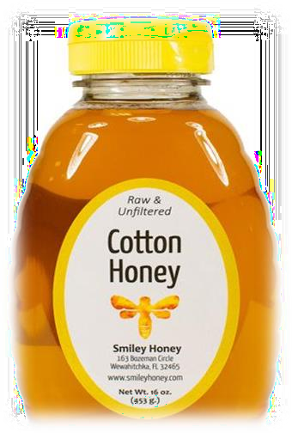
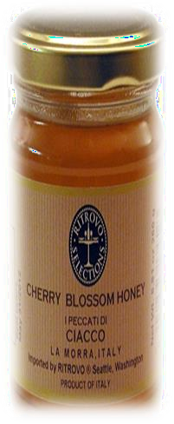
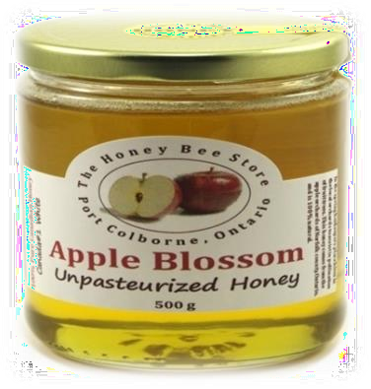
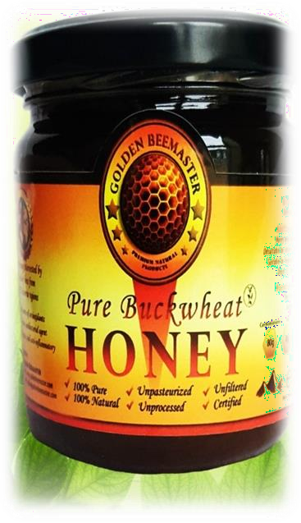

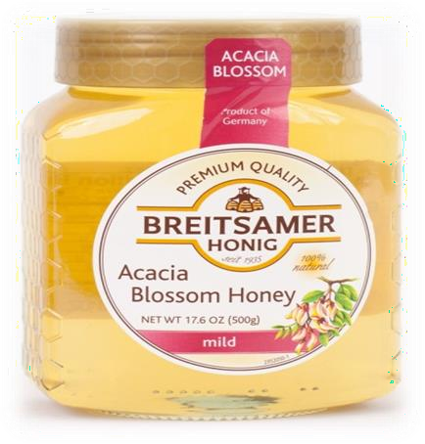


BLOSSOM HONEY > 300 VARIETIES
Type | Countr y | Type | Country
Sunflower | India | Buckwheat | USA
Eucalyptus | India | Lavender | Spain and France
Mustard | India | Manuka | New Zealand
Cotton | India | Rubber | India and Srilanka
Cashew | India | Heather | UK, Greece ,France
Apple | India | Apple | USA and Britain
cherry | India | Avocado | USA , Israel, India
Litchi | India | Clover | New Zealand, Canada

Slide 8







FLOW DIAGRAM OF HONEY PROCESSING
Harvesting and Transport of Raw Honey
Liquefaction
Straining
Filtration
Moisture
Reduction
Pasteurization
Cooling
Bottling
Labelling

Slide 9
HONEY PROCESSING
Honey is a natural and almost untreated food produced by bees. Honey is therefore highly regarded by consumers as an authentic, naturally pure and healthy product.
Thus, the honey processing / packaging is reduced only to the careful heating of raw honey for :
Liquefaction
Filtration
Moisture control (if unripe honey harvested)
Pasteurization
Packaging

Slide 10
REASON TO REDUCE MOISTURE IN HONEY
Moisture is one of the most important parameter of honey quality.
Most of the extracted honeys are having the higher moisture than the prescribed standards because of extraction of unripened honey.
The amount of water present in honey determines its stability against fermentation and granulation .
Honey having high water content ferments easily with time. So, it is necessary to process the honey by subjecting it to thermal treatment to prevent fermentation by sugar tolerant yeasts .
Treatment in a closed system minimizes losses of volatile aroma during heating.

Slide 11
Conti...
Gill et al. (2015) developed a small scale honey dehydrator for Moisture reduction.
Hot water is discharged in a water jacket around the honey pot to heat the
honey.
The heated honey pumped through a filter with 122 holes uniform in size, 0.5 cm diameter to form a honey stream through which the drying air passes to remove the honey’s moisture content.
The honey flow helps them to increasing the honey's surface to be exposed
with the air.
The maximum drying speed per square meter of honey exposed to drying air at 40°C is 197 g/ hour-m2 while the minimum result (74.8 g/ hour-m2) corresponds to air drying at room temperature 8 -17°C.

Slide 12
EQUIPMENTS FOR MOISTURE REDUCTION
Wakhle et al. (1996) developed a honey moisture reduction unit which consisted of falling film evaporator.
In this multiple effect evaporation system, raw honey was preheated (40–45 ºC)
and then filtered through 80 lm polypropylene micro-filter.
This honey was heated up to 60–65ºC in first effect to destroy
osmo-phillic yeast cells, held at 60ºC for evaporation of water under vacuum
Then cooled in third effect before passing into settling tanks for bottling.
The system had a capacity of processing 300 kg of honey per day.

Slide 13
Conti...
An another equipment which is used consist of a closed housing with an inlet port on the top side and an outlet port on the bottom edge.
The honey will enter the inlet port and flows downward across a series of
trays arranged in a zig zagged manner up to the outlet port.
A metal screen is used on each tray to spread the honey evenly throughout the tray. There are a coil and an evaporator heater used to dry and warm the air circulated over the honey layer to remove moisture.
This process claimed in reduced honey's water content from 20 % to 18.5%
with an airflow rate around 28 m3/min. and a temperature used around 49 °C
The equipment is shown in the picture in next slide.

Slide 14
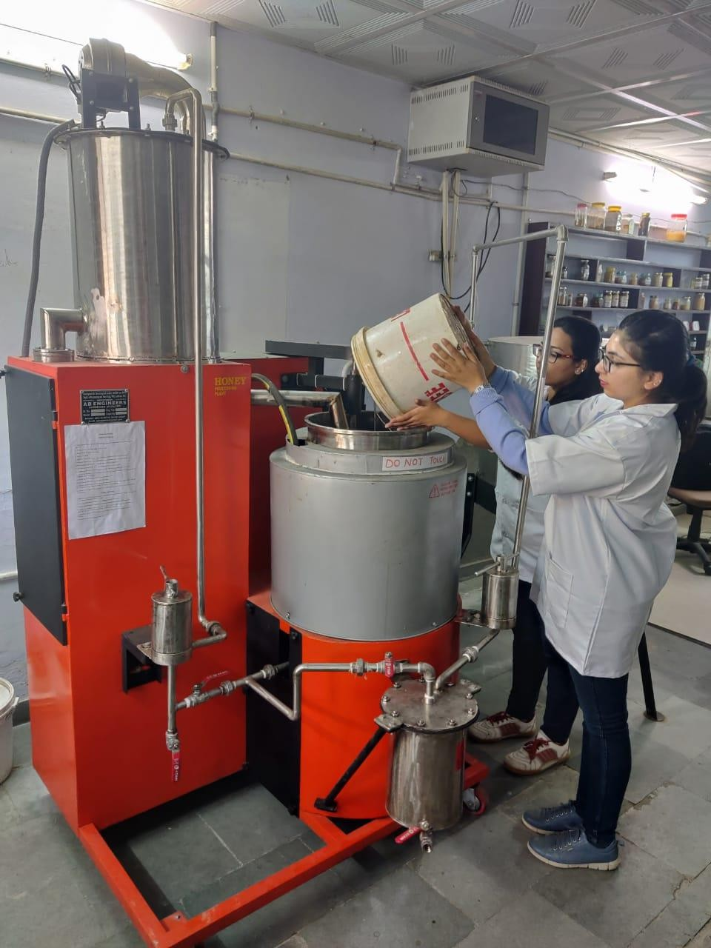
MOISTURE REDUCTION MACHINE

Slide 15


